Slide 1
COBOL 101 – Writing your first Cobol program

Slide 2
AGENDA for today
What is COBOL?
Structure of COBOL
Each COBOL division
COBOL sections
Example Program

Slide 3
What is COBOL?

Slide 4
What is COBOL?
COBOL – Common Business Oriented Language
Often associated with mainframes
Created in the 1950’s to serve many institutions
  Business, Financial, Governmental, and more
Designed to be easily readable by humans
  Even with no prior coding knowledge
  Not a difficult language to pick up
Many important sectors of modern world that rely on COBOL
  Banking systems, governmental agencies (social security), insurance systems, healthcare systems

Slide 5
What is COBOL?
Many consider COBOL to be a dying language, and will be replaced
  True in some cases, but not all
  Fact: There are over 800 billion lines of COBOL code that run daily, and have been working for over 60 years
With that much code running, it would be impossible to replace it all
There is a decreasing amount of COBOL developers, as most new developers do not consider COBOL
This is going to be a brief crash course on COBOL, if interested in learning more, check document on our GitHub for this crash course

Slide 6
Structure of COBOL Program

Slide 7
Structure of COBOL program
COBOL code needs to be organized in specific columns, depending on information on a line
  Lines 1-6 should always be empty
  Line 7 should be used for indicators
    Such as comments or continuation lines
  Lines 8-11 is “Section A” of a COBOL program
    Belongs to names such as division names, and 01 level items
  Lines 12-72 is “Section B” of a COBOL program
    Belongs to all other information in a program
    Such as program logic or value clauses
  Any lines past 72 should remain blank – compiler ignores them

Slide 8
Structure of COBOL program
There are 4 divisions that exist within a COBOL program
  Identification division, environment division, data division, and procedure division
Within these divisions, there are also subdivisions – which are called sections
These 4 divisions should be defined in the order listed here
  Every COBOL program should start with an identification division
  Every COBOL program should end with a procedure division
Each division/section provides a valuable role to a COBOL program
Note: while not strictly required with newer versions of COBOL, it is very common to type COBOL in all caps

Slide 9
Quick Note on Terminology
Quick note on some common COBOL terminology
The term – Paragraph
The term paragraph is commonly used when referring to blocks of COBOL code
In other languages such as C++, you may think of the term function
While not the exact same, for introductory purposes, you could think:
  Paragraphs = functions
Will refer to this term during the crash course

Slide 10
Identification divison

Slide 11
Identification division
The starting point for a COBOL program
Purpose: provide compiler with basic information about program
1 required field: Program-id
Many other fields may also be included, determined by programmer or company they are programming for
  Usually serve as documentation purposes, such as:
    Name of programmer, date written, date compiled
  These are not required by compiler in any way

Slide 12
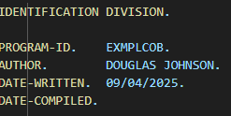
Identification division

Slide 13
Environment division

Slide 14
Environment division
There are 2 sections that exist here
  Configuration Section & Input-Output Section
  Configuration Section is optional in modern times
  Input-Output Section is still very relevant
In the Input-Output Section, there are 2 paragraphs that can be included
  I will only touch on the mandatory one – File Control
File Control Paragraph
  Used to define the relationship between file names in program logic to to external files
  These files can be both input and output
  This is done using what are known as SELECT … ASSIGN statements

Slide 15
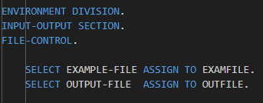
Environment division

Slide 16
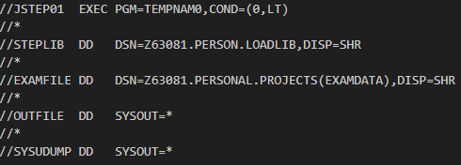
Environment division
The first file mentioned is the file name that will be used within the COBOL code that refer to that file
The second file mentioned is the file name that will refer to the DD statements in the JCL that use those names

Slide 17
Data DIvision

Slide 18
First – Picture Clauses
Very important to understand when discussing data division
Picture clauses, or PIC clauses, are used to define the type, size, and format of a data item
Two types for beginners – PIC X and PIC 9
  PIC X refer to alphabetical data, PIC 9 refer to numerical data
  EX: PIC X(25) refers to alphabetical data with 25 characters
  EX: PIC 999 refers to numerical data with 3 characters
Note: With numerical data, you may notice a S between the PIC and the 9’s, this represents a signed number
Note: You may also notice a V between 9’s, this represents an implied decimal place to the compiler

Slide 19
DATA division – file section
The first section to mention from the data division is the file section
Used to define input and output file structures
Each file that follows the SELECT clause should be defined here
Allows you to refer to specific parts of a input record using variable names
Knowing the data you are processing is one of the most significant parts of being a COBOL developer

Slide 20
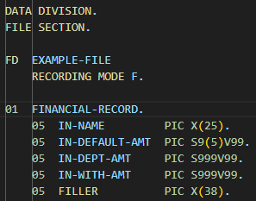
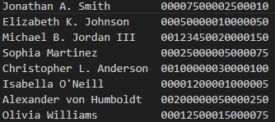
DATA division – file section

Slide 21
DATA division – working-storage section
The next section to mention is the working-storage section
Used to declare all program-level variables to be used in the procedure division. This includes:
  Variables for printing (detail lines, header lines)
  Variables used for computations
  Counters and flags
While there is no program logic itself here, most of the work of COBOL developer might spend on a program could be within this section
Note: Each print line must be composed of 132 bytes

Slide 22
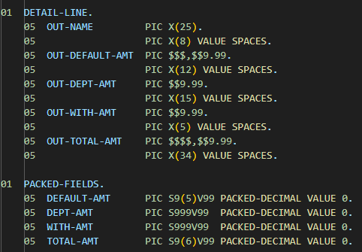
DATA division – working-storage section

Slide 23
Procedure Division

Slide 24
Procedure Division
The final division of a COBOL program is the procedure division
This is where the program logic and instructions are written
  Using the form of paragraphs
The other 3 divisions are all set up for the procedure division
Where you tell the compiler instructions of what you want your program to do, and how to manipulate the data
Some common things done within the procedure division include:
  Reading from/to files
  Performing computations
  Looping through all the records of a dataset
  Moving data to its proper field
  Calling other programs or subroutines to perform other tasks

Slide 25
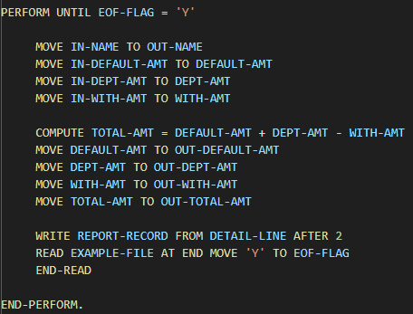
Procedure Division

Slide 26
The Results

Slide 27
The results
The entirety of this example COBOL program, along with the JCL and input data to execute can be found on our GitHub
I will do a live demonstration of this example COBOL program
Same demonstration as last week for JCL, except will focus on the COBOL program for this, as well as the input data

Slide 28
THANK YOU for Coming!

